Slide 1

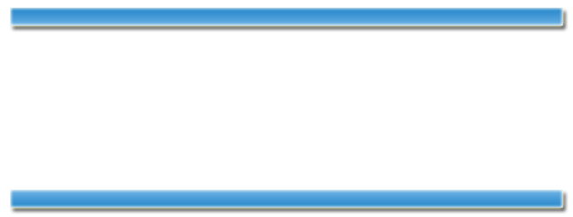
Feasibility and framing of interventions based on public support: leveraging text analytics for policymakers
Philippe J. Giabbanelli, Jean Adams, Venkata Sai Pillutla
HCI International- 20th July 2016

Slide 2
Organization
Background
Policy Making & Importance of Public opinion Current approaches
Case Study - Data collection
News articles collection
Data cleansing and wrangling
Case study - Data Analysis
Off-the-shelf software
Advanced analysis – Text Summarization
Giabbanelli et al.
Feasibility and framing of interventions based on public support..
2

Slide 3
Background
Giabbanelli et al.
Feasibility and framing of interventions based on public support..
3

Slide 4
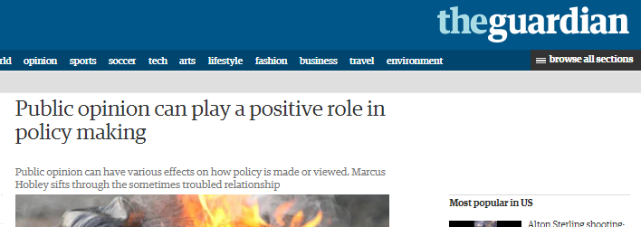
Background
Importance of public opinion in policy making
Existing approaches
Surveys
Qualitative analysis
Giabbanelli et al.
Feasibility and framing of interventions based on public support..
4

Slide 5
Background
Qualitative analysis – data collection
Focus groups(group discussions)
Individual interviews
Participation/observation
Require a lot of time and manpower to analyse the data.
Alternative - Off-the shelf software
Jigsaw, IN-SPIRE, Luminoso from MIT Media Lab, TopicNets
Giabbanelli et al.
Feasibility and framing of interventions based on public support..
4
Notes:
Manpower and timeconsuming

Slide 6
Case Study - Data Collection
Giabbanelli et al.
Feasibility and framing of interventions based on public support..
5

Slide 7
Case Study
Taxes on Sugar sweetened beverages(SSB) in California 2014-15.
The two SSB taxes in our case study were put to the vote in 2014 in Berkeley and San Francisco, California.
In Berkeley, CA, the tax was $0.01 per fluid ounce and the tax revenue was designed to go into the city’s general fund
Giabbanelli et al.
Feasibility and framing of interventions based on public support..
6

Slide 8
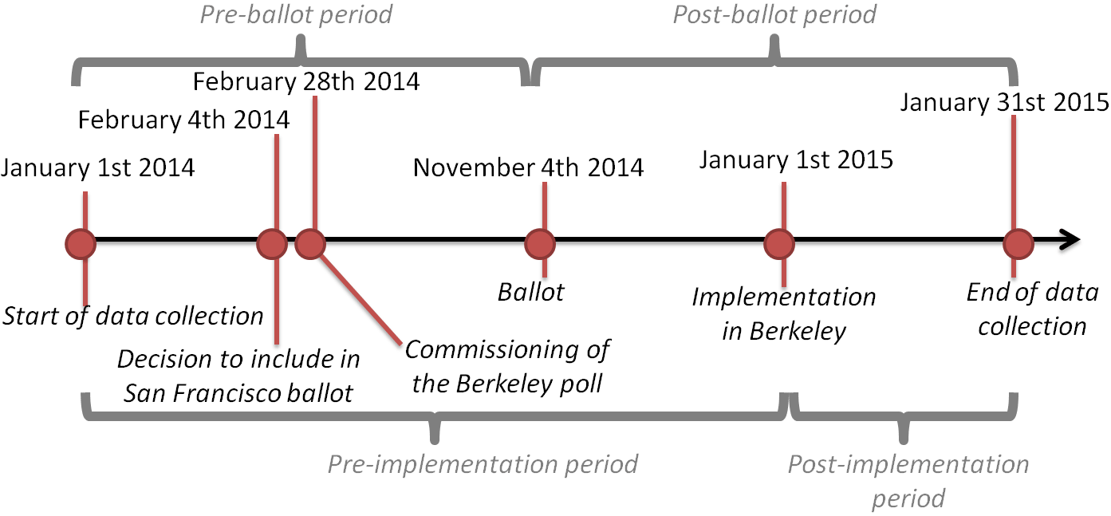
Case Study
Case study: Taxes on Sugar sweetened beverages(SSB) in California 2014-15.
Giabbanelli et al.
Feasibility and framing of interventions based on public support..
6

Slide 9
Case study - Data Collection
News articles vs Twitter data.
Box 1. Selection Criteria.
(Berkeley OR San Francisco) AND tax AND
(soda OR sweetened beverage OR sugary drink) OR
(Berkeley AND measure D) OR
(San Francisco AND Proposition E)
Giabbanelli et al.
Feasibility and framing of interventions based on public support..
6

Slide 10
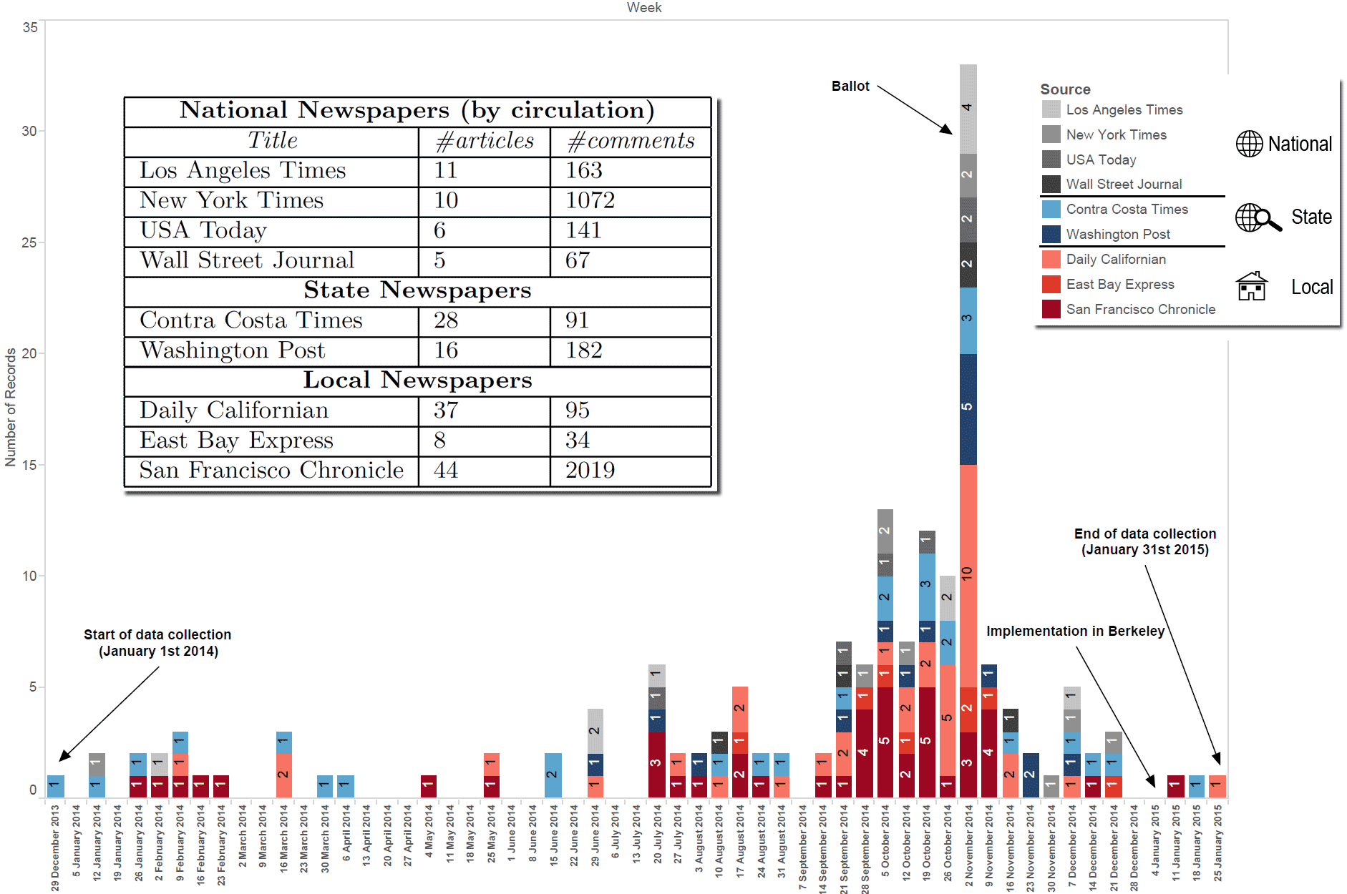
Data Collection
Corpus Size : 9 newspapers with 165 articles and 3,864 comments
Data Cleansing : separating articles and comments, MetaData
Giabbanelli et al.
Feasibility and framing of interventions based on public support..
7

Slide 11
Case Study - Data Analysis
Giabbanelli et al.
Feasibility and framing of interventions based on public support..
8

Slide 12
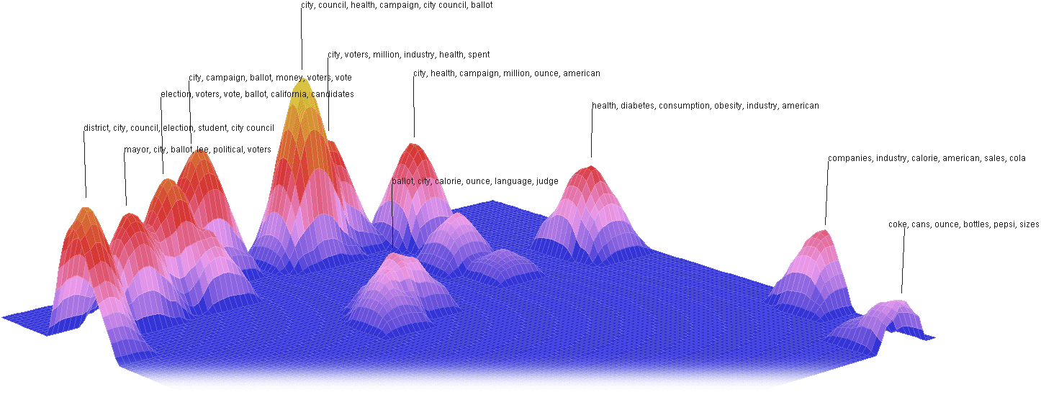
Case Study - Data Analysis
Themes : Both Jigsaw or IN-SPIRE allow themes to emerge (through clustering)
Giabbanelli et al.
Feasibility and framing of interventions based on public support..
9

Slide 13
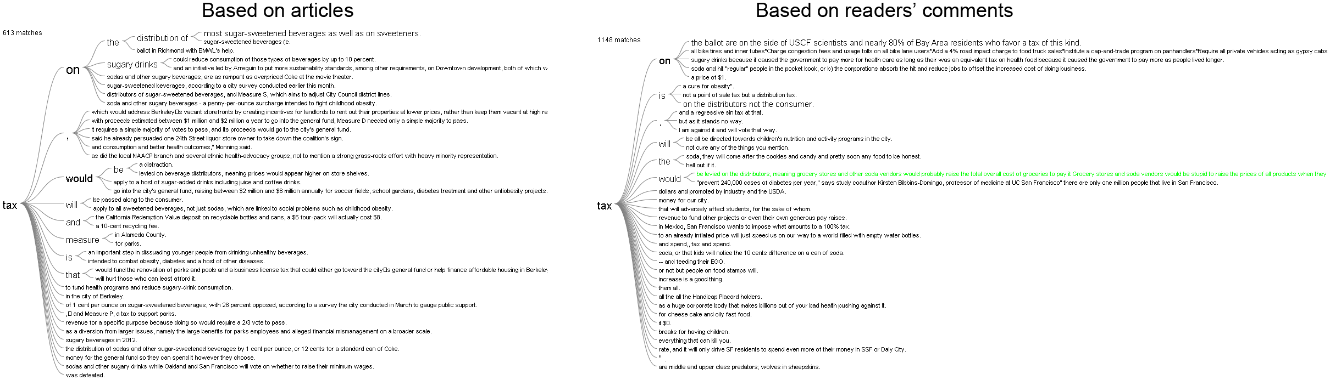
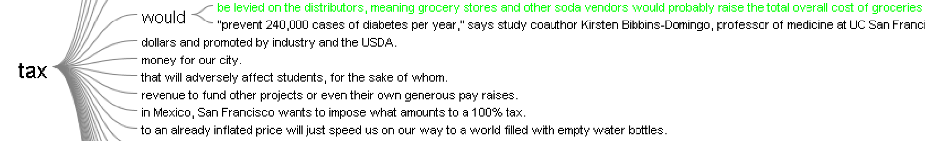
Case Study - Data Analysis
‘what do people say about tax?’
Giabbanelli et al.
Feasibility and framing of interventions based on public support..
10

Slide 14
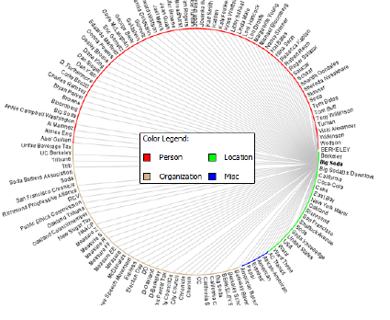
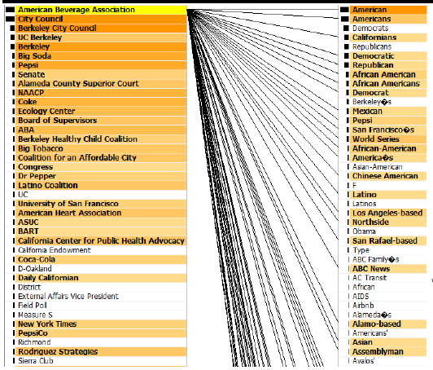
Case Study - Data Analysis
How Organizations are associated - Entity Tracking
Giabbanelli et al.
Feasibility and framing of interventions based on public support..
11

Slide 15
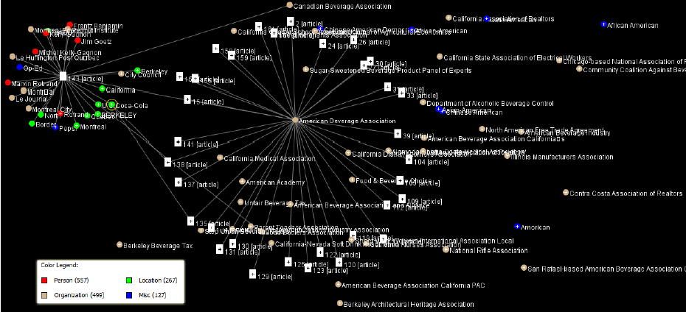
Case Study - Data Analysis
How Organizations are associated - Entity Tracking
Giabbanelli et al.
Feasibility and framing of interventions based on public support..
12

Slide 16
Advanced Analysis
Text Summarization
Extraction
Abstraction
Three Extraction based Approaches
Naive summarization – word frequency based summarization
LexRank - Graph based summarization
Lexical chain based summarization
Giabbanelli et al.
Feasibility and framing of interventions based on public support..
13

Slide 17
Advanced Analysis
Naive Summarization - word frequency based summarization
Sentences with the frequent words constitute the summary.
Example:
“A rocket is a missile, spacecraft, aircraft or other vehicle that obtains thrust from a rocket engine. Rocket engine exhaust is formed entirely from propellant carried within the rocket before use. Rocket engines work by action and reaction and push rockets forward simply by expelling their exhaust in the opposite direction at high speed, and can therefore work in the vacuum of space.
Rocket propellant is a material used by a rocket as, or to produce in a chemical reaction, the reaction mass (propulsive mass) that is ejected, typically with very high speed, from a rocket engine to produce thrust, and thus provide spacecraft propulsion.”
Giabbanelli et al.
Feasibility and framing of interventions based on public support..
14

Slide 18
Advanced Analysis
Naive Summarization - word frequency based summarization
Sentences with the frequent words constitute the summary.
Example:
“A rocket is a missile, spacecraft, aircraft or other vehicle that obtains thrust from a rocket engine. Rocket engine exhaust is formed entirely from propellant carried within the rocket before use. Rocket engines work by action and reaction and push rockets forward simply by expelling their exhaust in the opposite direction at high speed, and can therefore work in the vacuum of space.
Rocket propellant is a material used by a rocket as, or to produce in a chemical reaction, the reaction mass (propulsive mass) that is ejected, typically with very high speed, from a rocket engine to produce thrust, and thus provide spacecraft propulsion.”
Summary: Rocket propellant is a material used by a rocket as, or to produce in a chemical reaction, the reaction mass (propulsive mass) that is ejected, typically with very high speed, from a rocket engine to produce thrust, and thus provide spacecraft propulsion.
Giabbanelli et al.
Feasibility and framing of interventions based on public support..
15

Slide 19
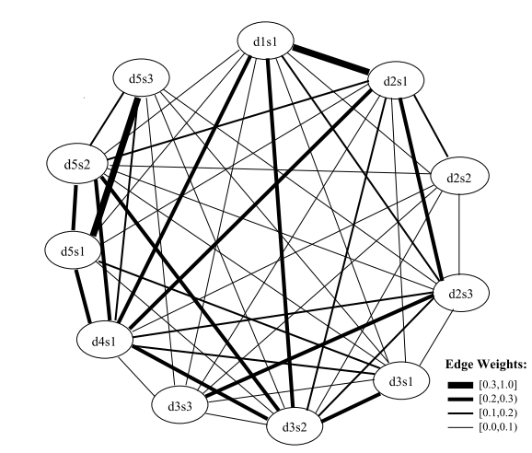
Advanced Analysis
LexRank - Graph based summarization
Source: http://arxiv.org/pdf/1109.2128.pdf
Giabbanelli et al.
Feasibility and framing of interventions based on public support..
16
Notes:
Figure 6. Graph Constructed based on similarity between sentences

Slide 20
Advanced Analysis
Lexical chain based summarization
Steps to Construct lexical chains
Mr. Kenny is the person that invented an anesthetic machine which uses micro-computers to control the rate at which an anesthetic is pumped into the blood. Such machines are nothing new. But his device uses two micro-computers to achieve much closer monitoring of the pump feed-ing the anesthetic into the patient.
Mr.
Micro-computer
Machine
Device
Person
Pump
Figure 7. Lexical chain constructed using an example
Giabbanelli et al.
Feasibility and framing of interventions based on public support..
17
Notes:
Lexical chains are constructed in three steps
1. Select a set of candidate words;
2. For each candidate word, find an appropriate chain relying on a relatedness criterion among members of the chains;
3. If it is found, insert the word in the chain and update it accordingly.
Relatedness : Extra-strong relations, Strong Relations, medium strong relations.

Slide 21
What we have discussed..
Policy Making, current approaches and importance of Public opinion
News article corpus vs Twitter data
Data cleansing and wrangling
Analysis using Off-the-shelf software
Advanced analysis using Text Summarization techniques
Contact Details
Venkata Sai Pillutla
http://www.dachb.com/
vpillutla@niu.edu
Full sized figures & scripts
https://osf.io/3x6av/
Giabbanelli et al.
Feasibility and framing of interventions based on public support..
19

Slide 22
Advanced Analysis
Lexical chain based summarization
Concepts represented by strong lexical chains give a better indication of the central topic of a text.
Scoring chains
Score(chain) = Length * HomogenityIndex
HomogenityIndex = 1 – number of DistinctOccurances/length
StrengthCriterion
Score(chain) > Average(scores) + 2 * StandardDeviation(scores)
Extracting significant sentences.
Giabbanelli et al.
Feasibility and framing of interventions based on public support..
18

